Slide 1
Mini Popper | Colt poppers | Pepper poppers | Plates | Wall feet
5 | 6 | 1 | 2 | 43
Bay | Stage | Target Type | Count | NS | Total | Hard Cover
1 | It Goes Away | USPSA | 2 |  | 2
2 | Why the Middle | USPSA | 11 | 5 | 16 | 2 Tux 1 50%
4 | Pacman | USPSA | 9 | 1 | 10 | 2 Tux 1 50%
5 | Hosing | USPSA | 10 |  | 10 | 1 Left Diag 1 Right Diag
7 | Matches Will Go On | IPSC | 9 | 2 | 11 | 2 Left Diag 1 Right Diag 1 50%
8 | CM 13-06 | USPSA | 5 |  | 5

Slide 2
Prop | Stage and Bay
Red Stitch Swinger | Stage 1, Bay 1
Drop Turner | Stage 1, Bay 1
Swinger | Stage 3, Bay 4
Max Trap | Stage 5, Bay 7

Slide 3


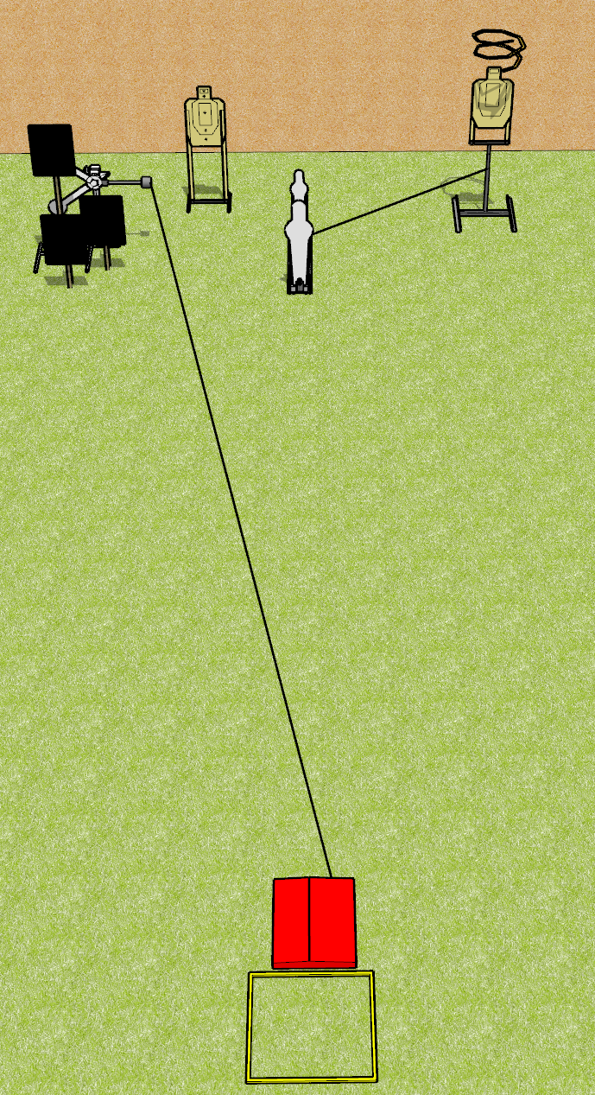
 | Dothan Gun Club – USPSA Match It Goes Away Course Designer : Drew Coleman Bay: 1
Round Count 8 rounds 2 USPSA 1 pepper popper, 1 mini popper, 2 plates
Equipment List Shooting box Stomp pad Red stitch target + activator + hard cover Drop turner + activator

Slide 4
It Goes Away
Written Stage Briefing
Scoring: Comstock
Rounds: 8
Targets: 2 USPSA and 4 steel
Handgun start position: heels touching the rear of the shooting box, wrists below belt. Handgun is loaded and holstered.
PCC start position: heels touching the rear of the shooting box, stock on belt. Loaded carbine is held with both hands, safety on.
Stage Procedure: on the audible start signal, engage targets as they become available from within the shooting area. The swinger is activated by the stomp pad and remains visible at rest. The stomp pad is part of the shooting area. The drop turner is activated by P1 and is a disappearing target.

Slide 5
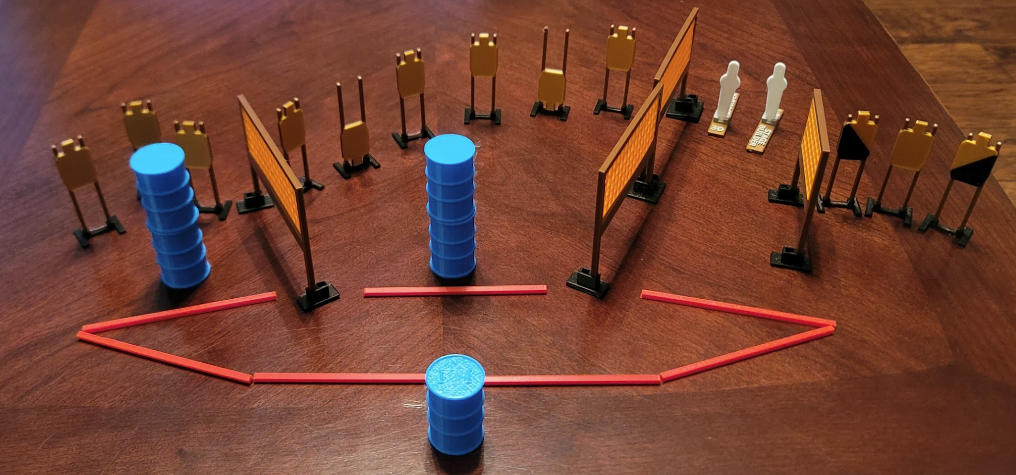
 | Dothan Gun Club – USPSA Match Hosing Course Designer : Eric Henwood Bay:
Round Count 26 rounds 12 USPSA 2 colt poppers
Equipment List 9 wall feet (probably need an extra wall in the middle) Use colts for the poppers

Slide 6
Hosing
Written Stage Briefing
Scoring: Comstock Rounds: 26
Targets: 12 USPSA, 2 steel
Handgun start position: anywhere inside the shooting area, wrists below belt. Handgun is loaded and holstered.
PCC start position: anywhere inside the shooting area, stock on belt. Loaded carbine is held with both hands, safety on.
Stage Procedure: on audible start signal, engage targets as they become available from within the shooting area.

Slide 7
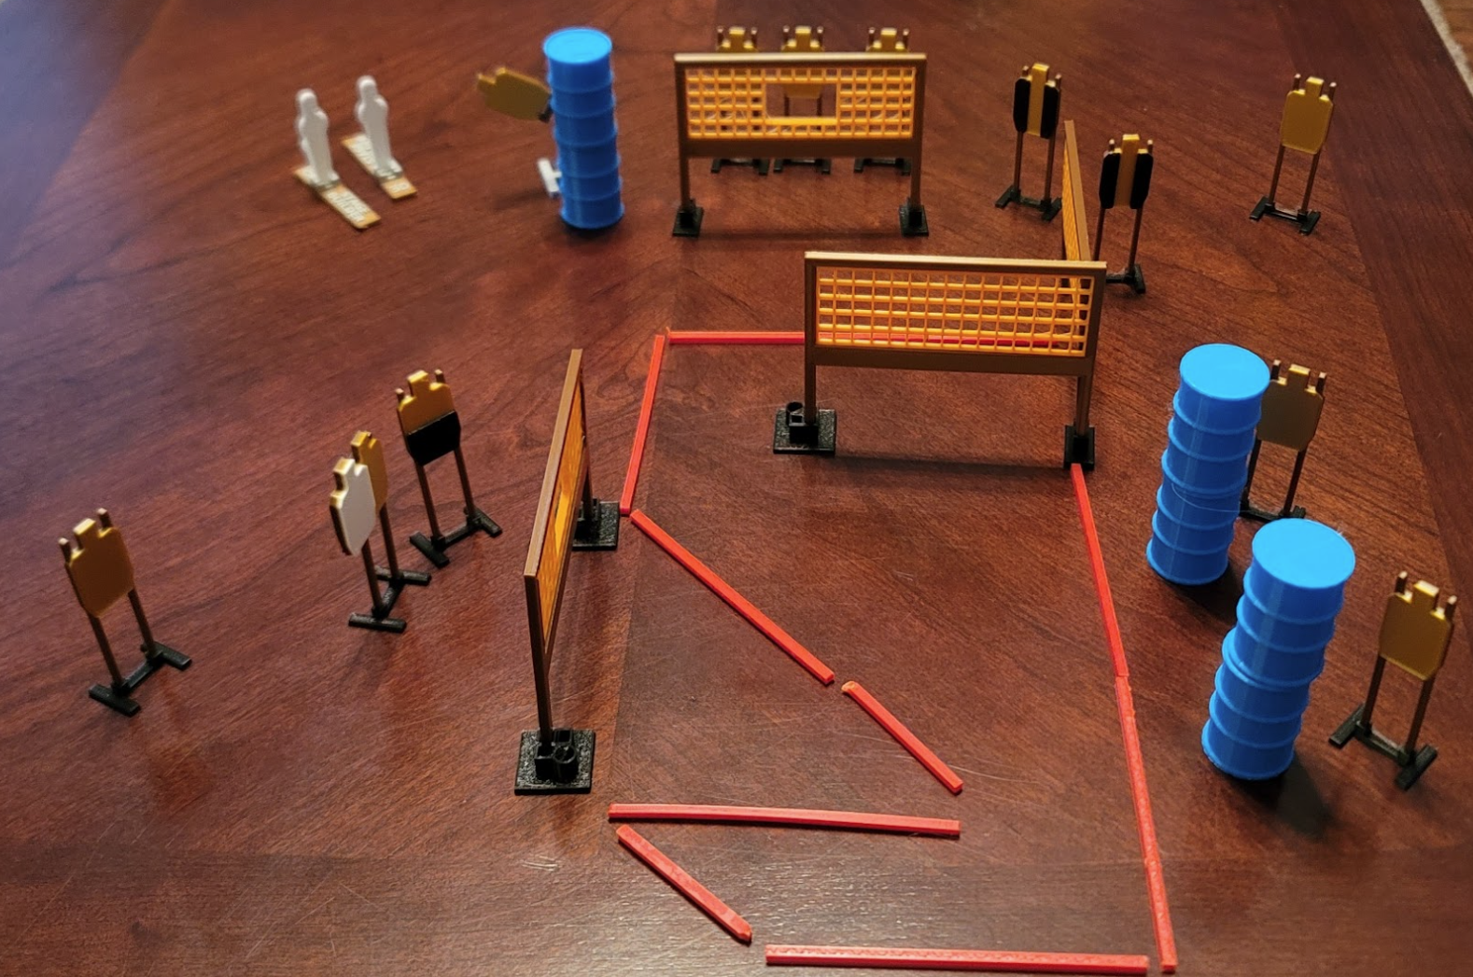
 | Dothan Gun Club – USPSA Match Pacman Course Designer : Eric Henwood Bay: 4
Round Count 26 rounds 12 USPSA 1 mini popper, 1 colt popper
Equipment List 7 wall feet 2 tux, 1 50% 10 targets (9 + 1 NS)

Slide 8
Pacman
Written Stage Briefing
Scoring: Comstock Rounds: 26
Targets: 12 USPSA, 2 steel
Handgun start position: anywhere inside the shooting area, wrists below belt. Handgun is unloaded and holstered.
PCC start position: anywhere inside the shooting area, stock on belt. Unloaded carbine is held with both hands, safety on.
Stage Procedure: on the audible start signal, engage targets as they become available from within the shooting area. The swinger is activated by P2 and remains visible at rest.

Slide 9
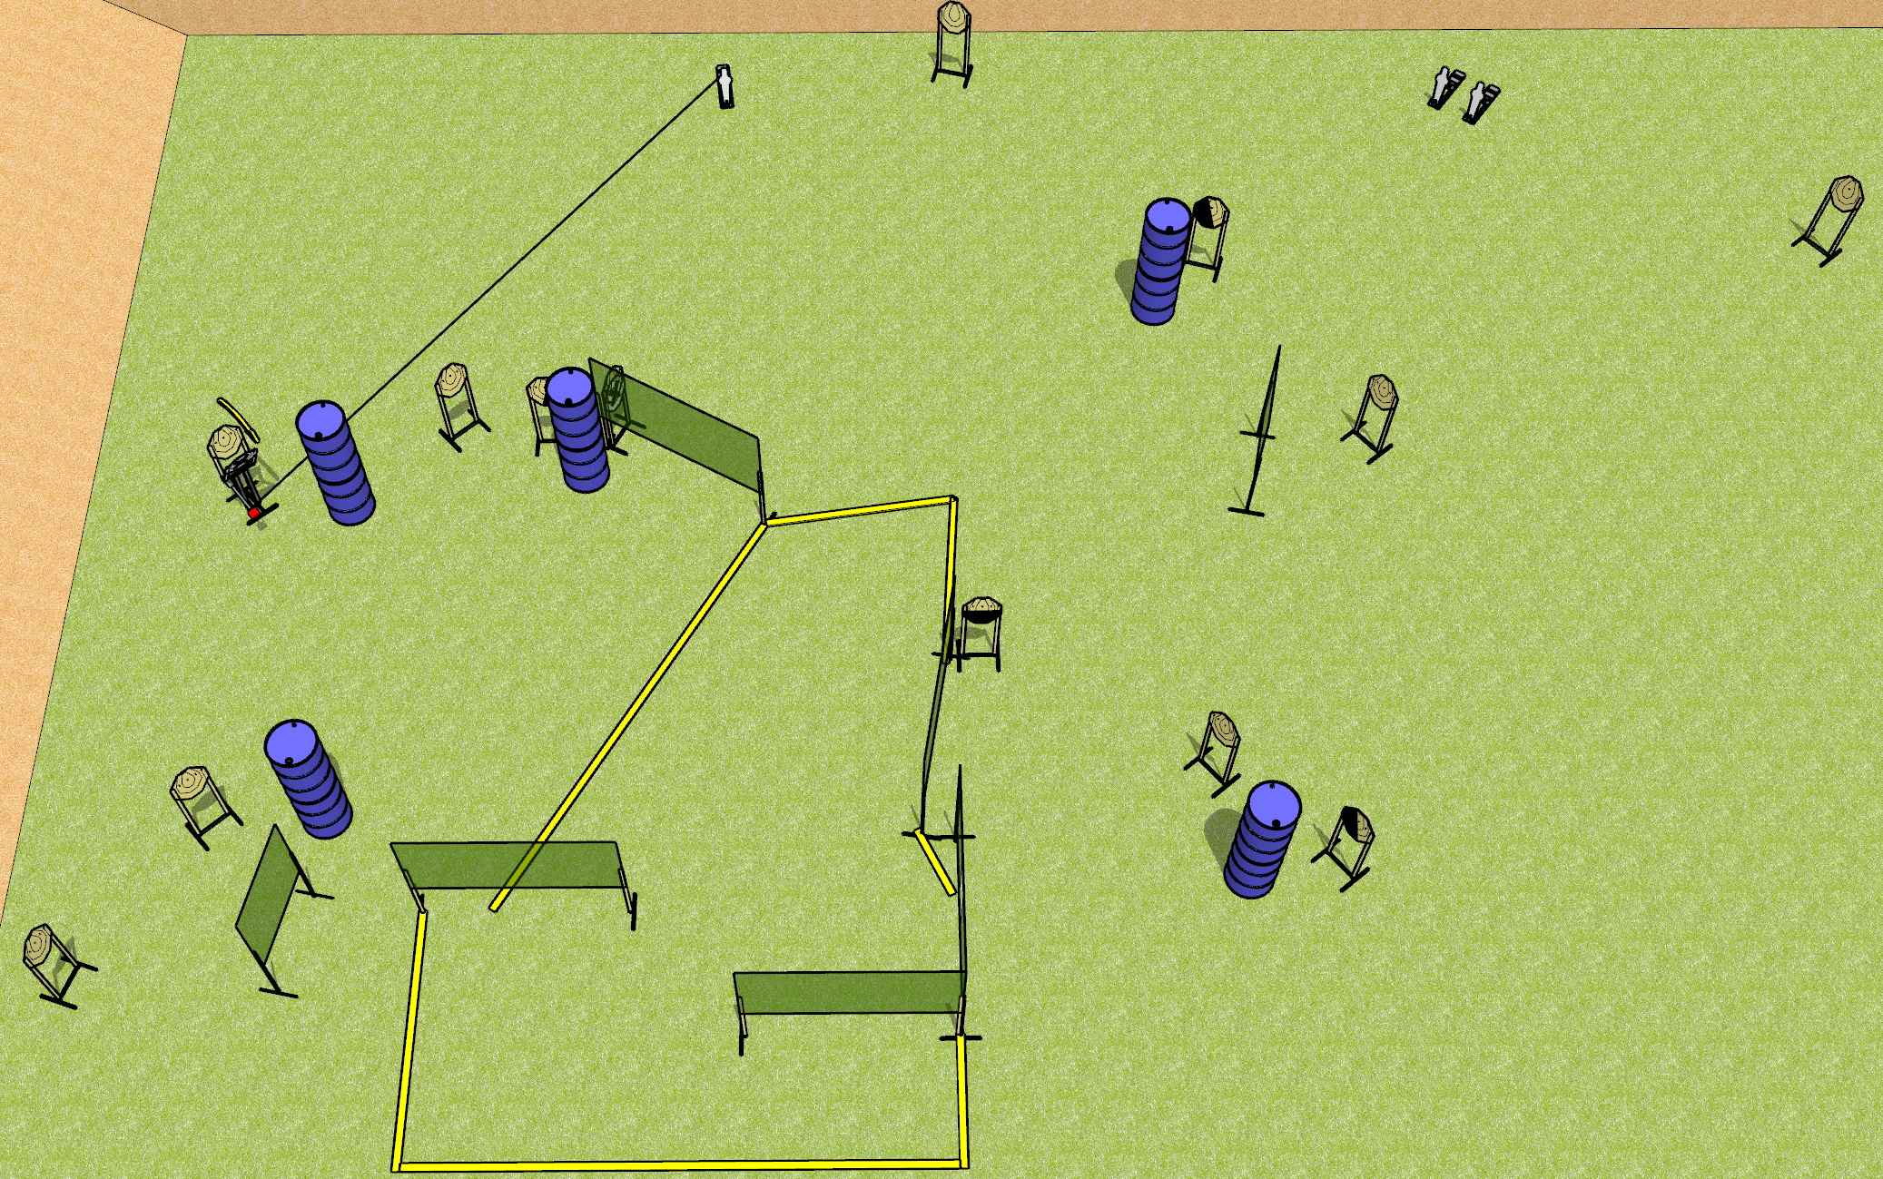
 | Dothan Gun Club – USPSA Match Matches Will Go On Course Designer : Drew Coleman Bay: 7
Round Count 29 rounds 13 IPSC 3 mini poppers
Equipment List 13 wall feet Max trap + activator 2 left + 1 right diag, 1 50%, 11 targets (9 + 2NS)

Slide 10
Matches Will Go On
Written Stage Briefing
Scoring: Comstock Rounds: 29
Targets: 13 IPSC, 3 steel
Handgun start position: anywhere completely outside the shooting area, wrists below belt. Handgun is loaded and holstered.
PCC start position: anywhere completely outside the shooting area, stock on belt. Loaded carbine is held with both hands, safety on.
Stage Procedure: On the audible start signal, engage targets as they become available from within the shooting area. The max trap is activated by P1 and remains visible at rest.

Slide 11
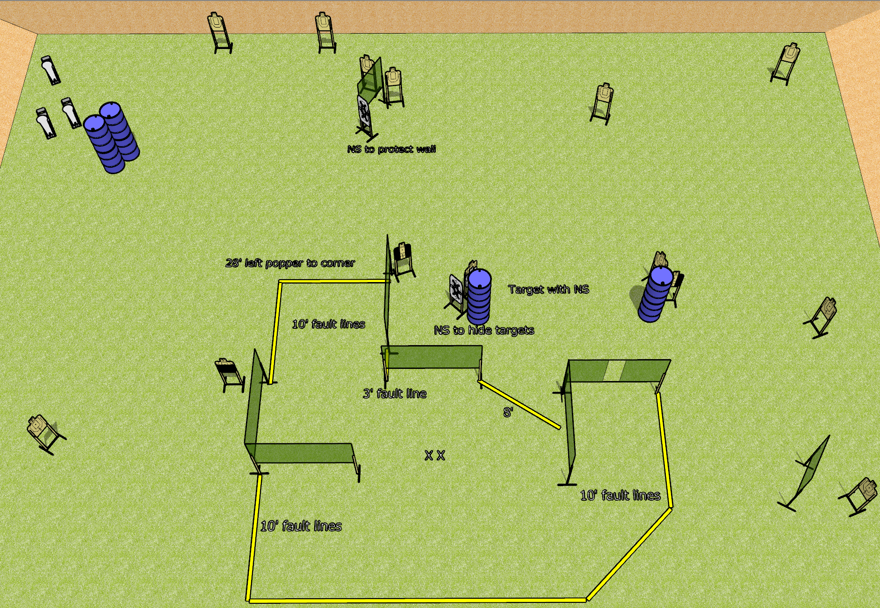
 | Dothan Gun Club – USPSA Match Why the Middle Course Designer : Drew Coleman Bay: 2
Round Count 31 rounds 14 USPSA 3 colt poppers
Equipment List 14 wall feet 2 tux, 1 50% 11 targets (10 + 1 NS), 3-4 NS targets for walls/blocking

Slide 12
Why the Middle
Written Stage Briefing
Scoring: Comstock
Rounds: 31
Targets: 14 USPSA, 3 steel
Handgun start position: both feet on X’s, wrists below belt. Handgun is loaded and holstered.
PCC start position: both feet on X’s, stock on belt. Loaded carbine is held with both hands, safety on.
Stage Procedure: on the audible start signal, engage targets as they become available from within the shooting area.

